Slide 1
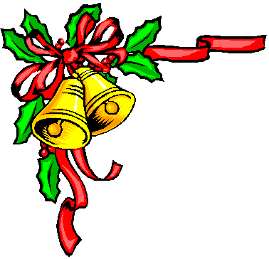
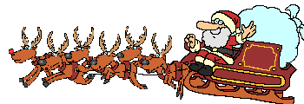
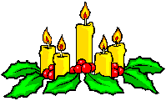
Noël en France

Christmas in France

Slide 2
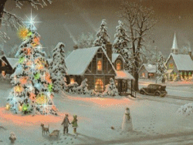
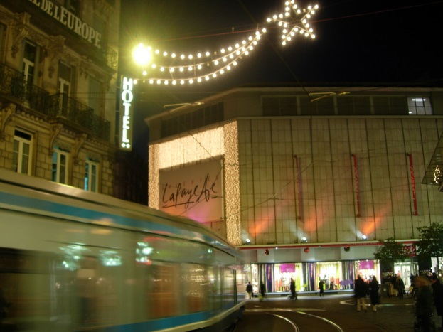
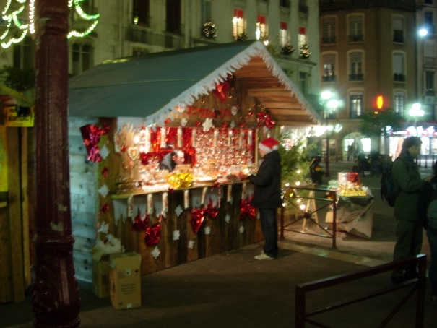
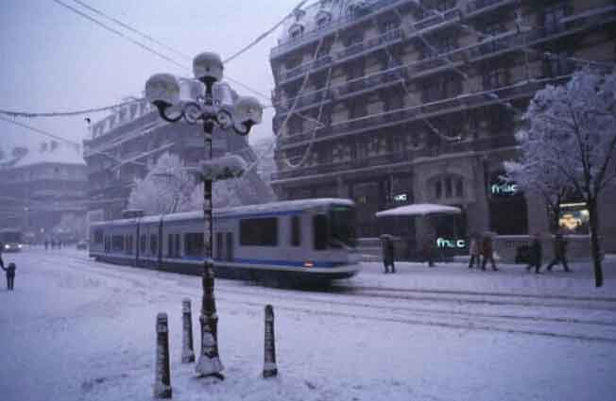
The celebration of Christmas in France varies between regions and between families. Some celebrate Christmas on 25th December, which is a bank holiday. Many families have their Christmas meal on the evening of 24th December (Christmas Eve). It is called Le Réveillon. (from the verb se réveiller – to wake up. Traditionally people have to stay up to be able to attend the Christmas mass).

Slide 3
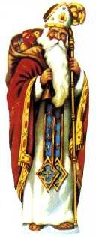
In the east (Alsace and Lorraine) and north of France, (as well as in Belgium, Germany, the Netherlands, Austria and Poland) the Christmas season begins on 6th December with la Fête de la Saint Nicolas.
Saint Nicolas was the bishop of the town of Myra (in modern day Turkey). He used to be famous for his generosity and became the patron saint of children. He is thought of have died on 06th December 310AD.

Slide 4
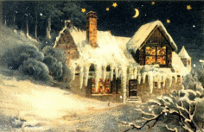
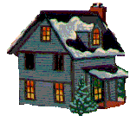
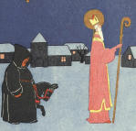
On the night of the 06th of December Saint Nicolas visits homes and schools. He travels with Le Père Fouettard (un fouet = a whip).
Le Père Fouettard is an evil butcher who was forever condemned to follow Saint Nicolas as a punishment for luring the little lost children into his shop. His name doesn't translate well, but means ‘Father Whipper’ .
Whereas Saint Nicolas brings small gifts and pain d’épices (gingerbread cake) to the children who have behaved well, le Père Fouettard canes bad children.

Slide 5
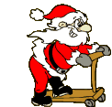
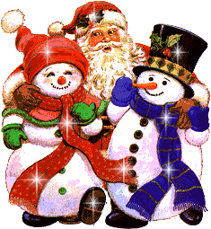

After the Reformation in the 16th century the celebration of Saint Nicolas was abolished in a few European countries. The Dutch, however, kept celebrating this catholic tradition – Dutch children continued to receive the visit of Sinterklaas (Saint Nicolas) .
At the beginning of 17th century the Dutch people who emigrated to the United States founded a colony called New Amsterdam (it became New York in 1664). Within a few decades the celebration of Saint Nicolas spread throughout the country and Sinter Klaas became Santa Claus.

Slide 6
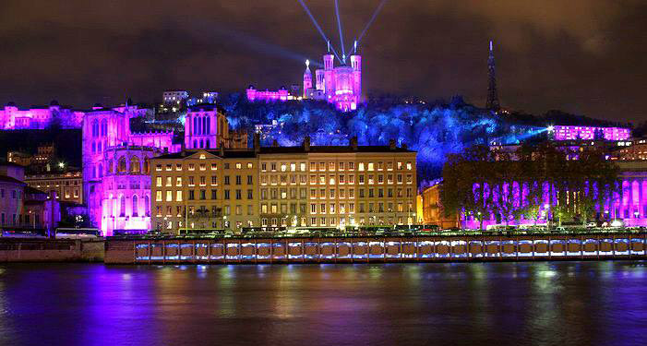
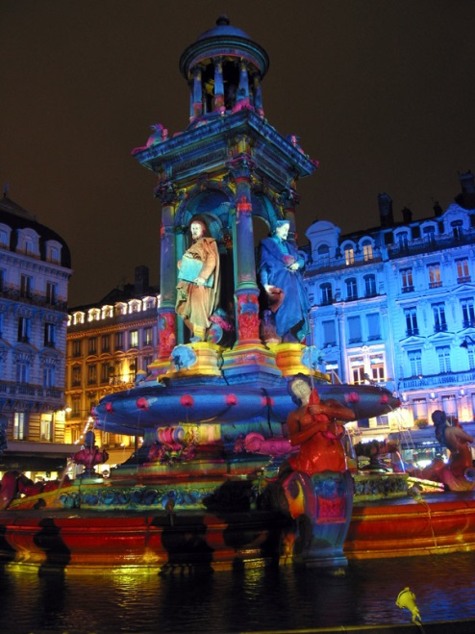
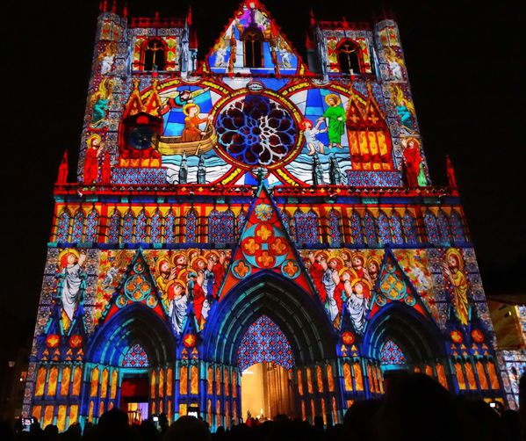
On 8th December the city of Lyon (South-East of France), celebrates la Fête des Lumières (Festival of Lights). The Lyonnais pay homage to the virgin Mary by putting candles in their windows which light up the city. In the evening of this celebration shops are open, houses are illuminated and people walk about in the streets, listen to music, visit each other and look into shop windows especially decorated for the occasion.

Slide 7
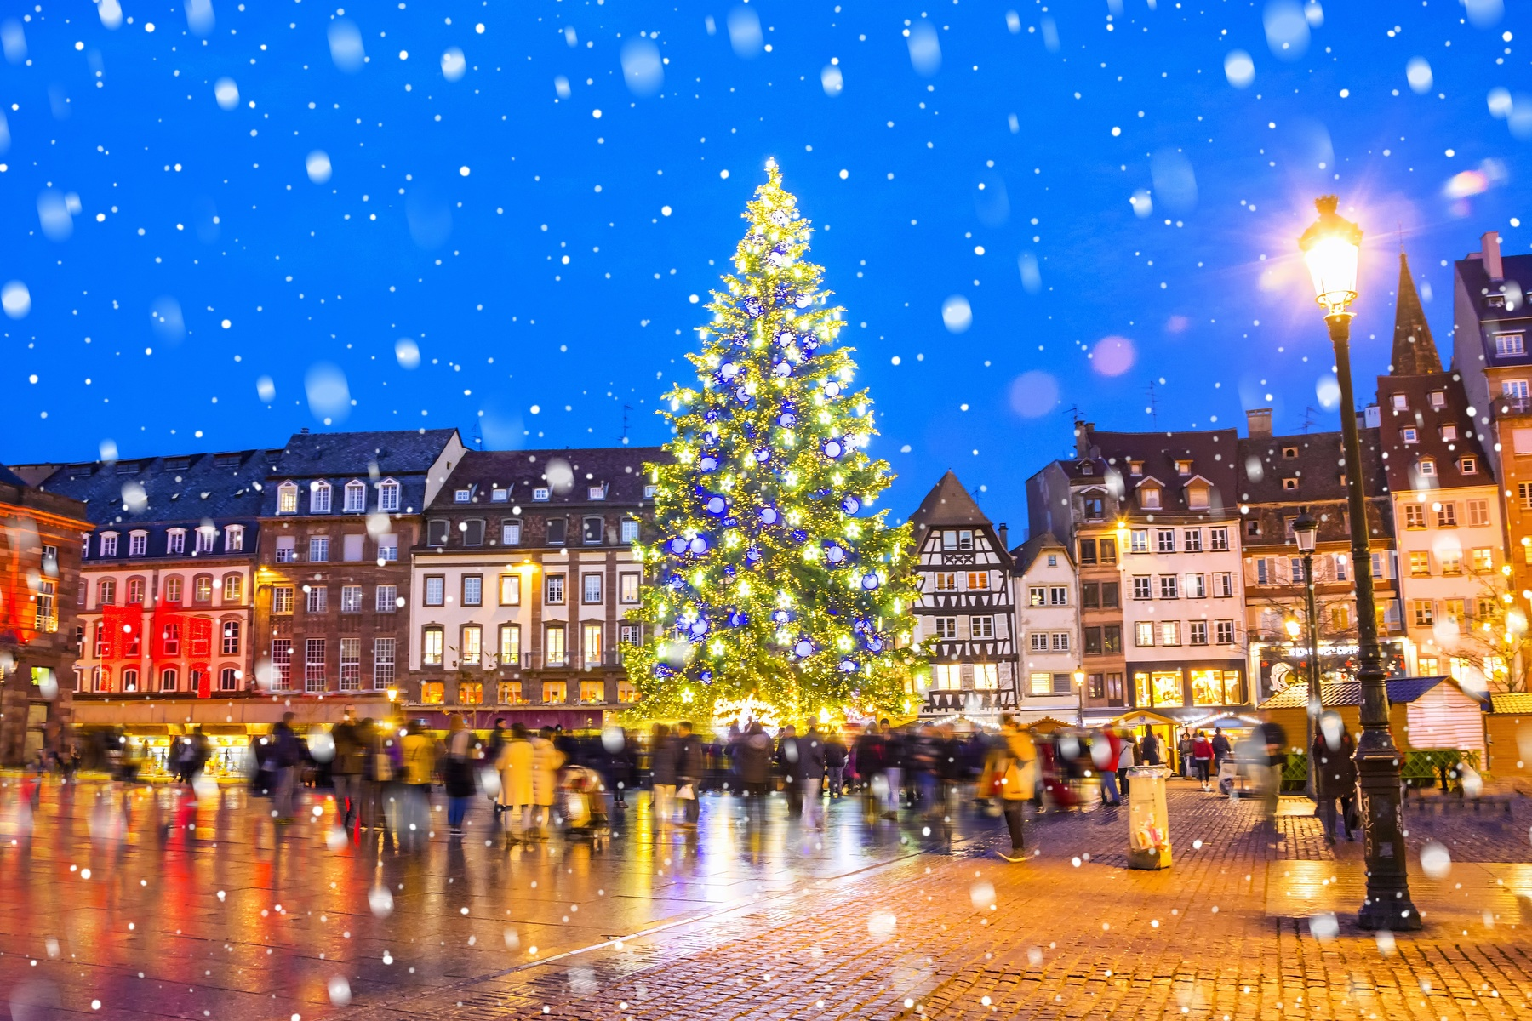
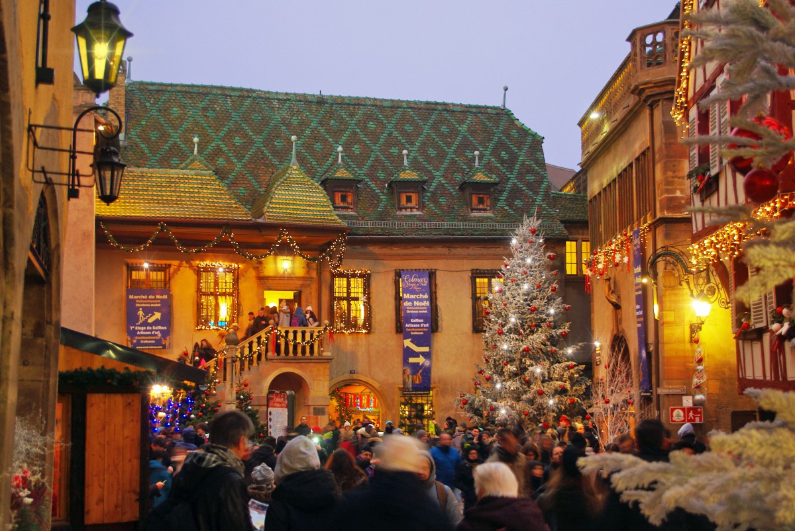
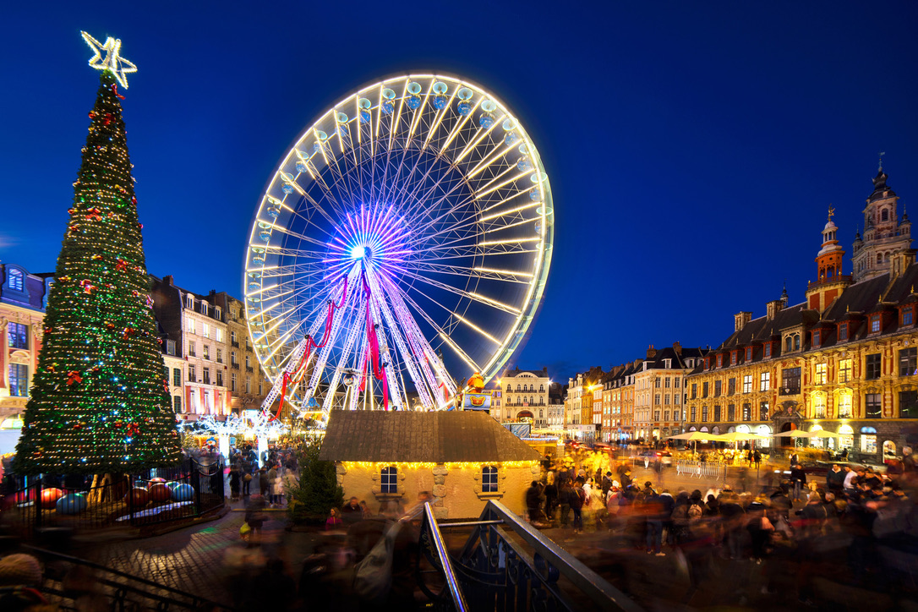
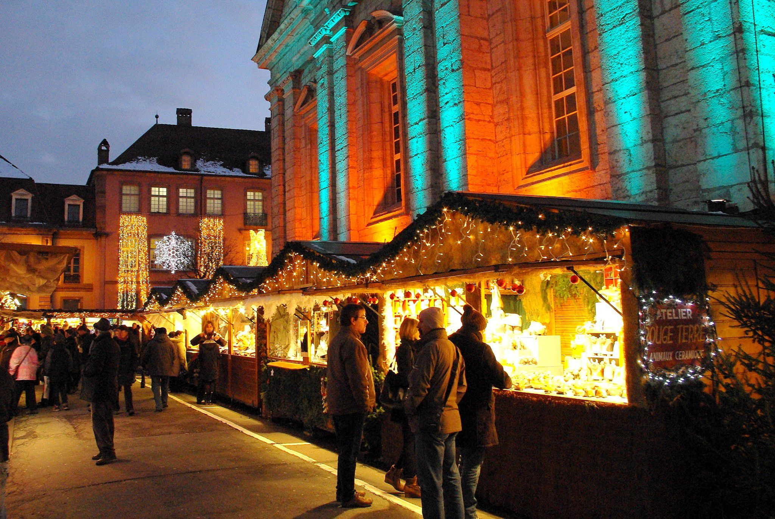
Christmas markets are other traditional events during the festive season.
The first Christmas market was held in Strasbourg (Alsace) in the 16th century. At the time the region was not part of France. It belongs to the Germanic Holy Roman Empire.
In the 1990’s Christmas markets spread to the rest of France. They are now held in cities but also towns and villages.
Strasbourg hosts the largest Christmas market in France.

Slide 8
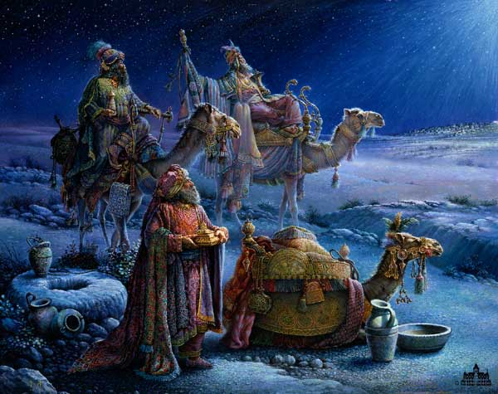
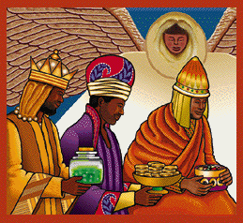
The Christmas season extends until 6th of January with the Epiphanie celebration. also known as La Fête des Rois. In some places in France it is celebrated on the first Sunday after 1st January.
The term Epiphany comes from the Greek Epiphanio which means ‘to appear’.
According to an old legend based on a Bible story, the Three Kings (aka Wise Men) Caspar, Melchior and Balthasar saw, on the night when Christ was born, a bright star, followed it to Bethlehem and found there the Christ child and presented it with gold, frankincense and myrrh.

Slide 9
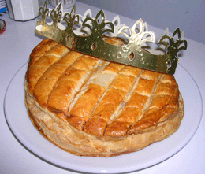
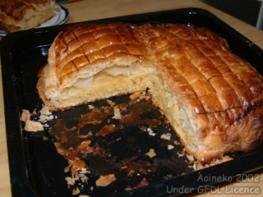

The Christmas tree is also taken down on 06thJanuary. On that day French households eat a Galette des Rois . This is an almond puff-pastry pie which is baked with a fève stuffed in the filling.
Fèves used to be dried beans. Beans were replaced by little ceramic figurines. Nowadays the fève is often made in plastic.
The person who finds the fève is crowned King or Queen of the family for a year. He/She wears a paper crown for the day and drops the fève into his/her chosen partner's glass.

Slide 10
Christmas Decorations

Slide 11
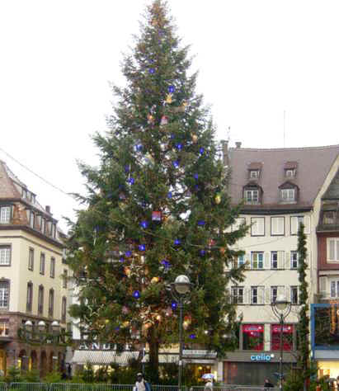
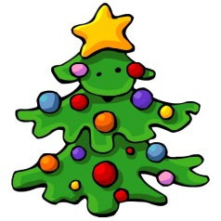
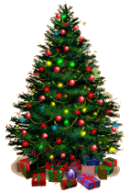
The sapin de Noël is the main decoration in homes, streets, shops, offices, and factories. The sapin de Noël appeared in Alsace - which was part of Germany - in the 14th century. A large fir tree was placed on the common.
On Christmas Eve, shows were organised in front of the church: people danced around the tree of paradise which was decorated with apples, paper flowers, and ribbons. Later on, the tree made its entrance in homes. At first, it was suspended from the ceiling with an apple tied to the trunk.
Then, people got into the habit of placing the fir tree in a large tray full of sand. The tree was shaken to let cakes and small gifts fall for the children.
The Christmas tree was introduced in France in 1837.

Slide 12
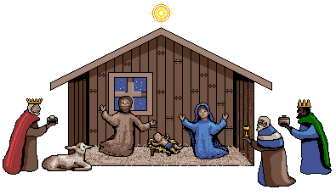
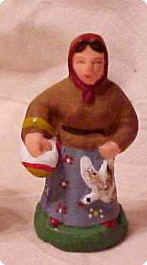
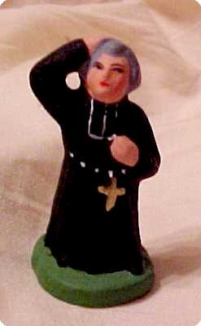
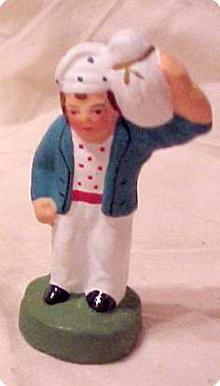
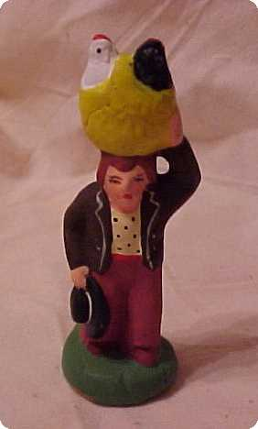
Another important aspect of French Christmas celebration is la crèche (nativity scene) filled little clayed figures called santons. It is displayed in churches and many homes.
An extensive tradition has evolved around these little figures which are made by craftsmen in the south of France throughout the year. In addition to the usual Holy Family, shepherds, and Magi, the craftsmen also produce figures in the form of local dignitaries and characters. Throughout December the figures are sold at annual Christmas fairs in Marseilles and Aix-en-Provence.

Slide 13
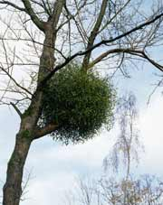
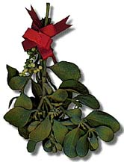
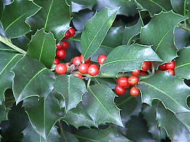

Mistletoe is hung above the door during the Christmas season to bring good fortune throughout the year.
Holly, with its prickly green leaves represents the Christ’s crown and the red berries, drops of blood.

Slide 14
Christmas Food

Slide 15
Le Réveillon is the huge feast that follows the Messe de Minuit (Midnight Mass) on Christmas Eve. Fewer and fewer French attend it and the Réveillon tends to start well before midnight. The word Réveillon comes from the verb réveiller (=to wake up or revive). Le Réveillon is a symbolic awakening to the meaning of Christ's birth and is the culinary high point of the season, which may be enjoyed at home or in a restaurant or café that is open all night. Each region in France has its own traditional Christmas menu, with dishes like chestnut-stuffed turkey, oysters, goose, chicken, boudin blanc (similar to white pudding), smoked salmon, snails, mussels, fois gras, etc.
Le Réveillon (Christmas Eve)

Slide 16
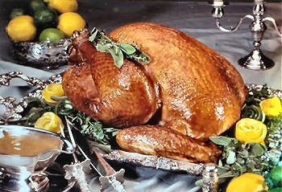
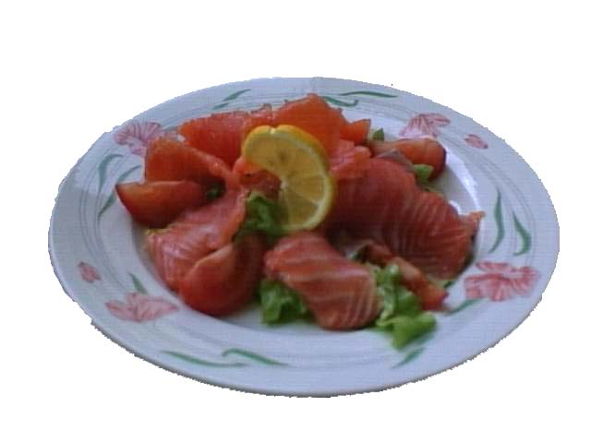
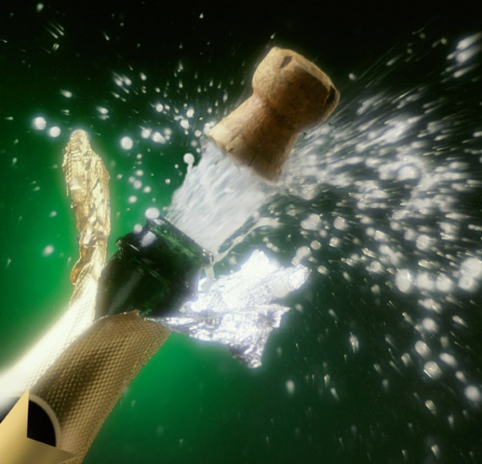

In Alsace, for example, goose is the main course.
In Burgundy it is turkey with chestnuts.
The Parisians feast upon oysters and pâté de foie gras.
There are also mussels, snails, smoked salmon, salmon, vols-au-vent filled in with seafood or mushrooms in a béchamel sauce and much more!
Drinks are wine and Champagne.

Slide 17
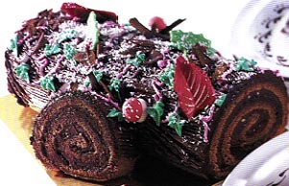
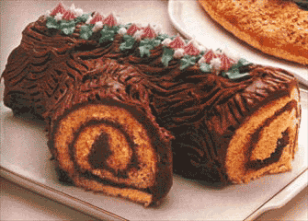
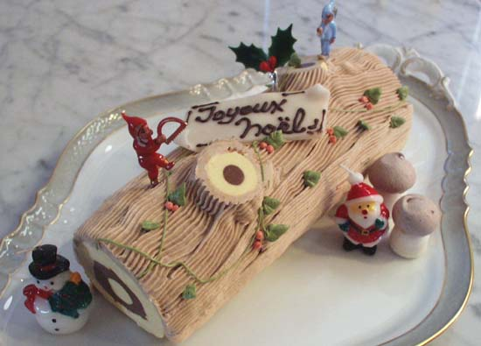
La bûche de Noël
The main Christmas dessert is
la bûche de Noël (Yule log).
It is a sponge cake filled with buttercream. It is rolled and shaped like a log. It is then covered in chocolate to make it look like a log.
Some bûches de Noël are made with ice cream.

Slide 18
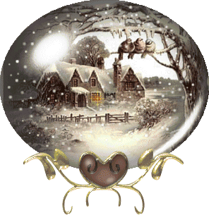
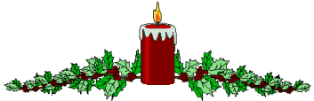
The log is a very ancient symbol associated with Christmas time.
The tradition of logs of wood and Christmas comes from the times before French people were Christian. People believed that some trees had very special powers which were made stronger through burning the wood and using the ashes. Part of the log was used to make the wedge for the plough as good luck for the coming harvest. People would burn the rest of the logs at a special festival in December called Yule. The logs had to burn slowly for a whole week. The family sat in front of the fireplace and children were taught tales and sang Christmas songs.
Then people would spread the ashes on their fields. They believed this would bring them a better harvest. They also spread the ashes in barns and lofts where they stored their corn because ashes kept rats away.

Slide 19
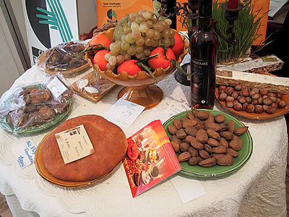
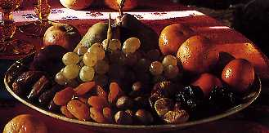
Les 13 desserts provençaux
In Provence, pudding is traditionally served with thirteen different desserts. Each dessert represented the twelve Apostles and Jesus. There are almonds, dried figs, raisins, walnuts, dates, apples, pears or grapes, mandarins, oranges, black nougat and white nougat, quince jam and a bread filled with paste made from sun dried tomatoes, or anchovy, olive oil and garlic (called pompe à huile or fougasse).

Slide 20
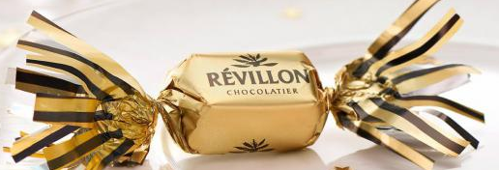
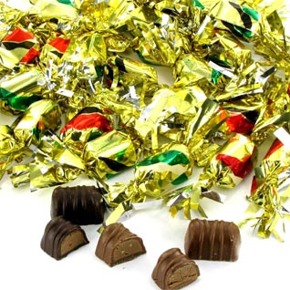
Les papillotes
The Christmas season also means time for a delightful chocolate confection called papillotes. Papillotes are fine chocolates wrapped in a small piece paper which reads a joke or a quotation from a famous person.
Papillotes were created in Lyon at the end of the18th century when the employee of a confectioner started to send small love notes wrapped around sweets to his lover who was working on the first floor. When his boss, Mr Papillot, discovered it, he dismissed the employee but found the idea very interesting and profitable.
Papillotes are now sold in most of France, mainly by supermarkets.

Slide 21

Joyeux Noël

